Slide 1

Associative Memory in Computer Organization
Computer Organization and Architecture | Memory & I/O Organization
Computer Organization and Architecture | Memory & I/O Organization | Bachelor of Engineering
DISCOVER · LEARN · EMPOWER
Notes:
Welcome everyone to today's lecture on Associative Memory. This topic is a critical component of the Memory and I/O Organization chapter. We will explore how this specialized memory type differs from standard address-based systems. By the end, you will understand its unique role in high-speed data retrieval.

Slide 2
Course Outcomes
SLIDE 2 / 10
Course Outcome
CO | BT LEVEL | DESCRIPTION
CO1 | BT3 | Apply number systems and digital logic to design basic digital circuits
CO2 | BT4 | Analyze register organization and instruction set architecture
CO3 | BT3 | Implement computer arithmetic algorithms and floating-point operations
CO4 | BT5 | Analyze memory hierarchy and input-output organization
CO5 | BT6 | Evaluate control unit design and pipelining performance
Chandigarh University
2 / 10
Notes:
Today's lecture directly addresses Course Outcome 4. You will learn to analyze how associative memory fits into the broader memory hierarchy. This specific technology optimizes input-output organization by speeding up look-up operations. Understanding this helps you design more efficient computer systems.

Slide 3
Learning Objectives
SLIDE 3 / 10
Learning Outcomes
1
Evaluate the fundamental working principle of associative memory systems.
2
Compare associative memory performance against conventional address-based memory.
3
Analyze the hardware architecture required for content-addressable storage.
4
Apply associative memory concepts to cache and translation look-up buffers.
5
Synthesize solutions for high-speed data retrieval in complex systems.
Chandigarh University
3 / 10
Notes:
Our goal is to move beyond simple definitions to advanced analysis. You will evaluate how associative memory works by comparing data content rather than addresses. We will analyze the specific hardware needed to perform parallel comparisons. Finally, you will apply these concepts to real-world components like CPU caches.

Slide 4
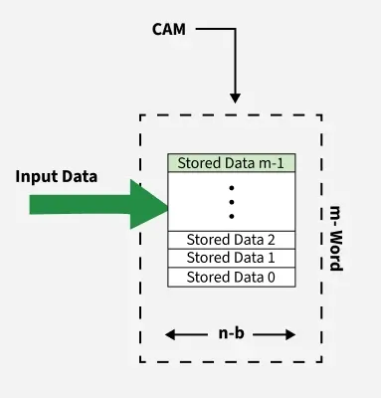
Lecture
SLIDE 4 / 10
Definition and Core Concept
1
Associative memory retrieves data based on content rather than a specific address.
2
It is also known as content-addressable memory or CAM in technical literature.
3
The system compares the input search key against all stored data simultaneously.
4
This parallel processing allows for extremely fast data retrieval speeds.
5
It functions as a specialized lookup table for specific high-speed applications.
What is Content-addressable Memory? - GeeksforGeeks
Chandigarh University
4 / 10
Notes:
Unlike standard RAM where you must know the address to find data, associative memory works differently. Imagine looking for a name in a phonebook by scanning every page for the name rather than using the index. The system compares your input against all stored entries at the exact same time. This parallel search capability is what makes it so powerful for specific tasks.

Slide 5
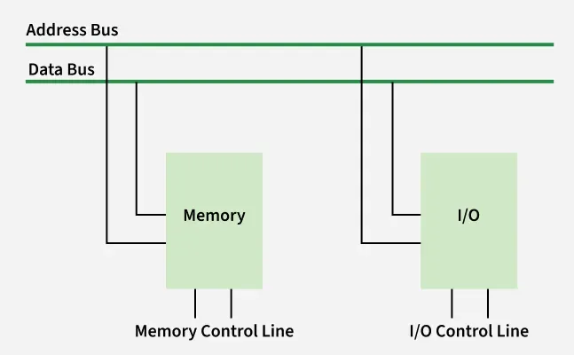
Lecture
SLIDE 5 / 10
Working Principle and Comparison
1
The search key is broadcast to all memory cells simultaneously for comparison.
2
Each cell contains a comparator that checks if its stored data matches the key.
3
Only the cell with a matching data pattern activates its output line.
4
The matching address or data is returned to the processor immediately.
5
This eliminates the need for sequential address decoding found in standard RAM.
Memory Mapped I/O and Isolated I/O - GeeksforGeeks (source: media.geeksforgeeks.org)
Chandigarh University
5 / 10
Notes:
When a search request arrives, the system broadcasts the key to every single memory cell at once. Each cell has a built-in comparator that checks if its stored value matches the incoming key. If a match is found, that specific cell signals the output line while others remain silent. This is why it is much faster than checking addresses one by one.

Slide 6
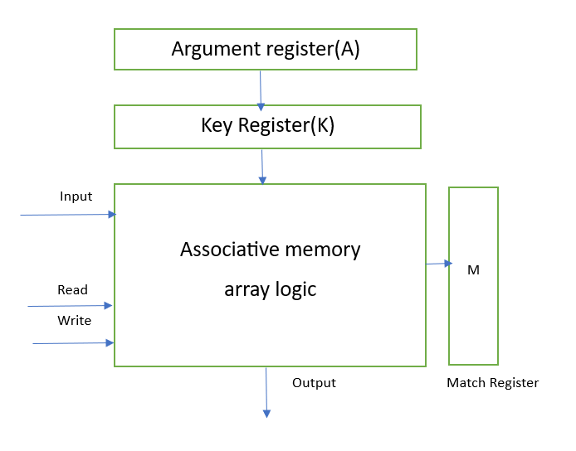
Lecture
SLIDE 6 / 10
Hardware Architecture and Cost
1
Each memory cell requires additional comparator circuitry and control logic.
2
This extra hardware makes associative memory significantly more expensive per bit.
3
The power consumption is higher due to the parallel comparison activity.
4
Density is lower compared to standard RAM because of the added circuitry.
5
Designers use it only where speed is critical and cost is secondary.
Associative Memory - GeeksforGeeks (source: media.geeksforgeeks.org)
Chandigarh University
6 / 10
Notes:
The trade-off for speed is cost and complexity. Every single bit in associative memory needs its own comparator circuit. This means a 1-kilobyte associative memory chip is much larger and more expensive than a 1-kilobyte standard RAM chip. Because of this, engineers reserve it for critical paths where speed is the absolute priority.

Slide 7
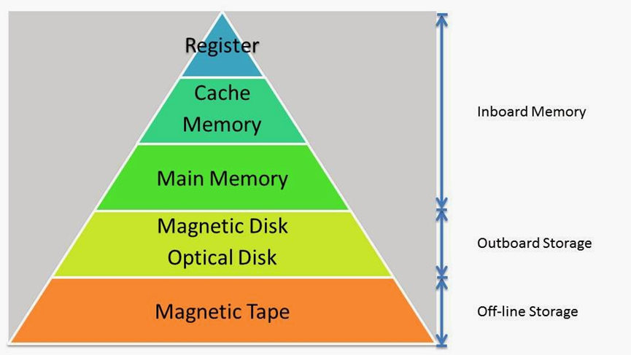
Lecture
SLIDE 7 / 10
Key Applications in Systems
1
Used in CPU caches to quickly check if data exists in the cache.
2
Essential for Translation Look-up Buffers (TLB) in virtual memory systems.
3
Found in network routers for high-speed packet header matching.
4
Utilized in database systems for rapid keyword searching and indexing.
5
Critical in pattern recognition tasks requiring instant data identification.
MEMORY ORGANIZATION. Introduction : What is memory… | by shrutii khatal | Medium (source: miro.medium.com)
Chandigarh University
7 / 10
Notes:
You encounter associative memory in your computer every day without realizing it. It is the engine behind CPU caches, allowing the processor to instantly find data. It also powers the Translation Look-up Buffer, which translates virtual addresses to physical ones. Without it, modern high-speed computing would be significantly slower.

Slide 8
Numerical Example
SLIDE 8 / 10
Speed Analysis
GOVERNING EQUATION
Speedup factor is calculated as 50,000 / 10 = 5000 × faster
1
Standard RAM access time is approximately 50 nanoseconds for sequential search.
2
Associative memory access time is roughly 10 nanoseconds regardless of size.
3
For a 1000-entry search, RAM takes 50,000 nanoseconds sequentially.
4
Associative memory takes 10 nanoseconds for the same 1000-entry search.
Memory Mapped I/O and Isolated I/O - GeeksforGeeks (source: media.geeksforgeeks.org)
Chandigarh University
8 / 10
Notes:
Let's look at a concrete example to see the difference. If you search a standard RAM for a specific item among 1000 entries, it might take 50,000 nanoseconds in the worst case. However, associative memory finds that same item in just 10 nanoseconds. This results in a speedup factor of 5000 ×, demonstrating why it is used for critical lookups.

Slide 9
Lecture
SLIDE 9 / 10
Key Takeaways
1
Associative memory retrieves data based on content, not physical address.
2
It uses parallel comparison to achieve extremely fast search speeds.
3
Higher cost and lower density limit its use to specialized applications.
4
It is vital for CPU caches and virtual memory translation buffers.
5
Understanding it is essential for analyzing modern memory hierarchy.
Source: media.geeksforgeeks.org
Chandigarh University
9 / 10
Notes:
To summarize, associative memory is a content-based retrieval system that trades cost for speed. It performs parallel comparisons to find data instantly, unlike sequential RAM access. While expensive, it is indispensable for high-performance components like caches and TLBs. Mastering this concept is key to analyzing the full memory hierarchy.

Slide 10
Lecture
SLIDE 10 / 10
References
COMPUTER ORGANIZATION AND DESIGN
The Hardware/Software Interface — David A. Patterson, John L. Hennessy
COMPUTER ARCHITECTURE
A Quantitative Approach — John L. Hennessy, David A. Patterson
• Computer Organization and Architecture — William Stallings
• Computer System Architecture — M. Morris Mano & Rajib Mall
• Computer Organization — Carl Hamacher, Zvonko Vranesic, Safwat Zaky
Chandigarh University
10 / 10
Notes:
These five textbooks provide the foundational knowledge for today's lecture. William Stallings and M. Morris Mano offer detailed explanations of memory organization. The works by Patterson and Hennessy provide quantitative approaches to performance analysis. Please refer to these texts for deeper study and further examples.

